Slide 1

ENT: FY’26 Performance & FY’27 Growth Strategy
Mike Stacy
President - Global Enterprise
April 2026

Slide 2
ENT Financial Overview: (FY’22 – FY’27)
Revenue Won | FY'26
Total Won | $14,941,656
Avg. Deal Size Won | FY'26
Total Won | $65,247

Slide 3
Confirmed Revenue Comparison
Amounts in ’000
ENT | FY'24 | FY'25 | FY'26 | FY'27
Confirmed | $2,249 | $6,765 | $7,537 | $5,575
Projected | $- | $- | $- | $-
Sales Goal | $15,250 | $10,819 | $11,302 | $12,332
Open-Existing | $109 | $376 | $134 | $170
Open-New | $92 | $290 | $126 | $323
Total (Budget) | $17,700 | $18,250 | $19,100 | $18,400
Confirmed |  | $4,516 | $772 | $(1,963)
Confirmed % |  | 201% | 11% | -26%
Sales Goals |  | $(3,966) | $78 | $1,263
Sales Goals % |  | -26% | 1% | 11%

Slide 4
ENT – Top Client Trend Analysis (FY’21–FY’26)
Amounts in ’000
Year | FY'21 |  | FY'22 |  | FY'23 |  | FY'24 |  | FY'25 |  | FY'26
Client Name | Rank | Amounts ($) | Rank | Amounts ($) | Rank | Amounts ($) | Rank | Amounts ($) | Rank | Amounts ($) | Rank | Amounts ($)
Ernst & Young | 1 | $4,080 | 1 | $3,112 | 2 | $1,301 | 14 | $381 | 14 | $335 | 10 | $395
PricewaterhouseCoopers | 2 | $2,869 | 2 | $1,185 | 1 | $2,010 | 16 | $316 | 10 | $592 | 30 | $60
KPMG LLP | 3 | $1,179 | 6 | $929 | 4 | $924 | 9 | $525 | 12 | $566 | 12 | $373
Freddie Mac | 4 | $890 | 7 | $830 | 11 | $434 | 15 | $370 | 44 | $33 | 0 | $0
Walmart | 5 | $725 | 14 | $274 | 14 | $241 | 4 | $1,038 | 3 | $936 | 6 | $666
Blue Cross Blue Shield NC | 6 | $615 | 9 | $612 | 6 | $731 | 7 | $808 | 5 | $781 | 4 | $782
Health Management Systems | 7 | $481 | 11 | $397 | 31 | $98 | 0 | $0 | 0 | $0 | 0 | $0
Dassault Systèmes | 8 | $411 | 16 | $194 | 13 | $272 | 35 | $59 | 19 | $124 | 25 | $100
Vertex Professional Services | 9 | $380 | 5 | $944 | 3 | $969 | 3 | $1,059 | 6 | $698 | 7 | $661
Red Hat | 10 | $304 | 15 | $229 | 43 | $49 | 38 | $52 | 0 | $0 | 0 | $0
EMERITUS Institute of Management | 13 | $221 | 8 | $719 | 9 | $572 | 32 | $67 | 81 | $0 | 0 | $0
AT&T | 18 | $124 | 0 | $0 | 0 | $0 | 1 | $4,457 | 1 | $6,301 | 1 | $5,452
WORKIVA INC | 23 | $106 | 10 | $403 | 5 | $850 | 2 | $1,132 | 4 | $819 | 8 | $550
Intuit | 30 | $69 | 4 | $972 | 0 | $0 | 0 | $0 | 0 | $0 | 0 | $0
Honeywell | 33 | $55 | 13 | $287 | 10 | $486 | 12 | $476 | 11 | $573 | 13 | $348
Uber | 40 | $45 | 3 | $1,060 | 7 | $643 | 5 | $999 | 16 | $310 | 16 | $220
Pacific Gas & Electric | 0 | $0 | 48 | $40 | 8 | $622 | 6 | $853 | 2 | $1,159 | 3 | $903
PMI | 0 | $0 | 0 | $0 | 0 | $0 | 11 | $480 | 7 | $680 | 2 | $2,100
Takeda Pharmaceuticals | 0 | $0 | 0 | $0 | 18 | $207 | 8 | $598 | 8 | $656 | 5 | $759
New York Life Insurance Company | 0 | $0 | 0 | $0 | 0 | $0 | 28 | $81 | 9 | $595 | 9 | $485
Mohela | 0 | $0 | 0 | $0 | 0 | $0 | 10 | $513 | 0 | $0 | 0 | $0

Slide 5



Wins and New Clients Addition – Financial Year 2025 - 26
 | $376,868
 | $167,000
 | $113,400
 | $66,000
 | $38,900
 | $12,600
 | $6,000
 | $0
 | $0
Total | $780,768
ASAP Elearning Solutions Ltd.

Slide 6

FY’26 - Initiatives
Automation
Adoption of client platforms like Ask AT&T
Automated storyboard-to-development workflows
Template-driven rapid course development
Automated quality checks and review cycles
Script-based publishing and LMS packaging
AI-driven voiceover and media generation
Automated content conversion from legacy formats
Reduced manual effort and improved turnaround time
AR/VR/XR & AI Capabilities Built
Immersive XR learning solutions for complex training scenarios
Interactive simulations for experiential learning
AI-powered content transformation and modernization
AI-assisted image, audio, and video generation
Microlearning and adaptive learning framework pilots
Differentiated innovation-led solution positioning
6

Slide 7
Growth Plan
FY’27 Strategy to Achieve Budget
Challenges Faced in FY’26
FY’26 - How FY’26 Initiatives Support FY’27 Growth
Launch AI XDT model
Train and certify AI resources
Leverage AI for business development and sales support
Focus on existing accounts for additional services
Increase RFP win ratio
Adding additional services and offerings
Drive business growth by promoting webinars and innovation showcases
Large clients such as AT&T, Walmart, Workiva, PG&E, PwC, Honeywell, and KPMG have declined.
Client budget constraints and phased project approvals
Delayed conversion of large RFP opportunities
Shift from large fixed projects to smaller engagements
Increased pricing pressure and competition
Upskilling requirement for emerging technologies
XDT model ensures predictable monthly revenue
Automation improves delivery efficiency and margins
AI accelerates development and reduces turnaround time
AR/VR/XR enables premium high-value offerings
Reusable assets support scalable delivery
Stronger client relationships improve upselling and cross-selling opportunities

Slide 8
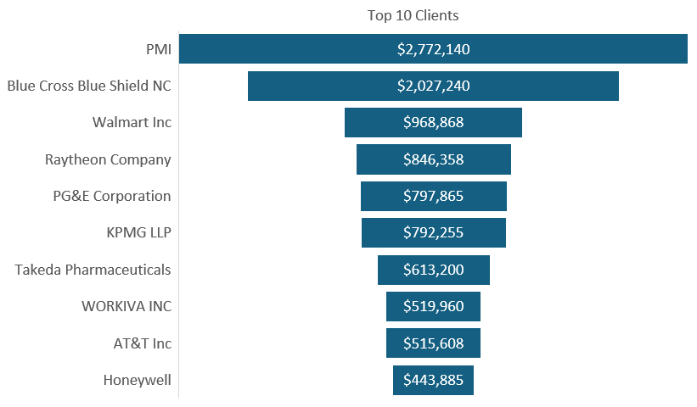
FY’26 – YTD - Enterprise Closed – Top 10 Clients
Top 10 Clients As per Deal value (ZOHO)
Client Name | Amount ($)
PMI | $2,772,140
Blue Cross Blue Shield NC | $2,027,240
Walmart Inc | $968,868
Raytheon Company | $846,358
PG&E Corporation | $797,865
KPMG LLP | $792,255
Takeda Pharmaceuticals | $613,200
WORKIVA INC | $519,960
AT&T Inc | $515,608
Honeywell | $443,885

Slide 9
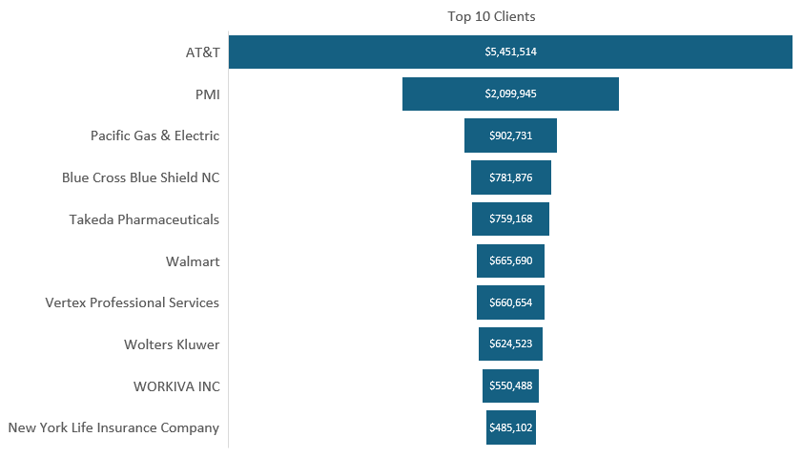
FY’26 – YTD - Enterprise Closed – Top 10 Clients
Top 10 Clients As per Invoicing
Client Name | Amount
AT&T | $5,451,514
PMI | $2,099,945
Pacific Gas & Electric | $902,731
Blue Cross Blue Shield NC | $781,876
Takeda Pharmaceuticals | $759,168
Walmart | $665,690
Vertex Professional Services | $660,654
Wolters Kluwer | $624,523
WORKIVA INC | $550,488
New York Life Insurance Company | $485,102

